Slide 1
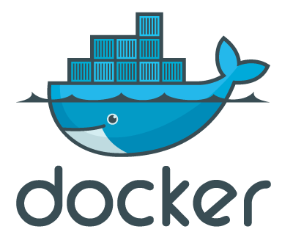
Docker Hack Night
The basics

Slide 2
Docker
Platform for running Apps
Containers, run everywhere
Tooling for containers
Small footprint
Linux only (ATM)

Slide 3
Docker
But how does it work?
App A
App B
Bins/Libs
Bins/Libs
App A
App B
Guest OS
Guest OS
Bins/Libs
Bins/Libs
Hypervisor
Docker Engine
Host OS
Host OS
Server
Server
VM
Docker

Slide 4
Docker
What’s in a box?
Linux Kernel Namespaces
Union File system
cgroups, iptables
Go, GIT
Docker Community Hub (registry)
Kernel >= 2.6.24

Slide 5
OK, so let’s go!

